Slide 1
THOUGHT LEADERSHIP STRAT PLAN
2017
First Quarter

Slide 2
“Thought leaders are informed opinion leaders and the go-to people in their field of expertise.”
Denise Brosseau

Slide 3
BACKGROUND OF PROJECT
TPC has been around for 15 years. We are known in the portrait photography industry, specifically baby photography. We are continuously offering new packages and new services (Ampersand & The Story Company), however, only a select few are aware of who we are and what we offer.
In this digital age, only a few see the value of what we do and what we offer.
TPC aims to change that. Through this project, we not only aim to place TPC at the top of the baby studio photography business, we will change public perspective on the value of printed portraits.

Slide 4
OBJECTIVES
Become baby experts online, the go-to source of authoritative information on anything baby related.
Be perceived as the baby experts of today, a status symbol in baby photography.

Slide 5
“We go beyond photography.”
Get people to care about TPC. Re-establish the perceived value that our brand is something that people ASPIRE for.

Slide 6
MAIN GOAL
Make TPC

Slide 7
TARGET MARKET
25 to 40 year-old females, moms. They reside in central business districts. They usually browse for furniture, travel in the places the likes of Aman Pulo and Balesin. Busy.
They have a lot of options on the internet. They are strong online shoppers and that they search for health information online. They frequently bank and play games online. Women also watch online video more than men.
They like information that is both useful and interesting. They want interaction with what they’re reading online.
Source: https://go.forrester.com/, eMarketer

Slide 8
PLATFORMS
Blog
FB
Instagram
Email

Slide 9
BLOG TITLE OPTIONS
Mommy Munchies
Bite-sized information for the mom in everyone.
Cafe Smiles
Your daily dose of happy.

Slide 10
BLOG PEG Romy & The Bunnies http://romyandthebunnies.com/

Slide 11
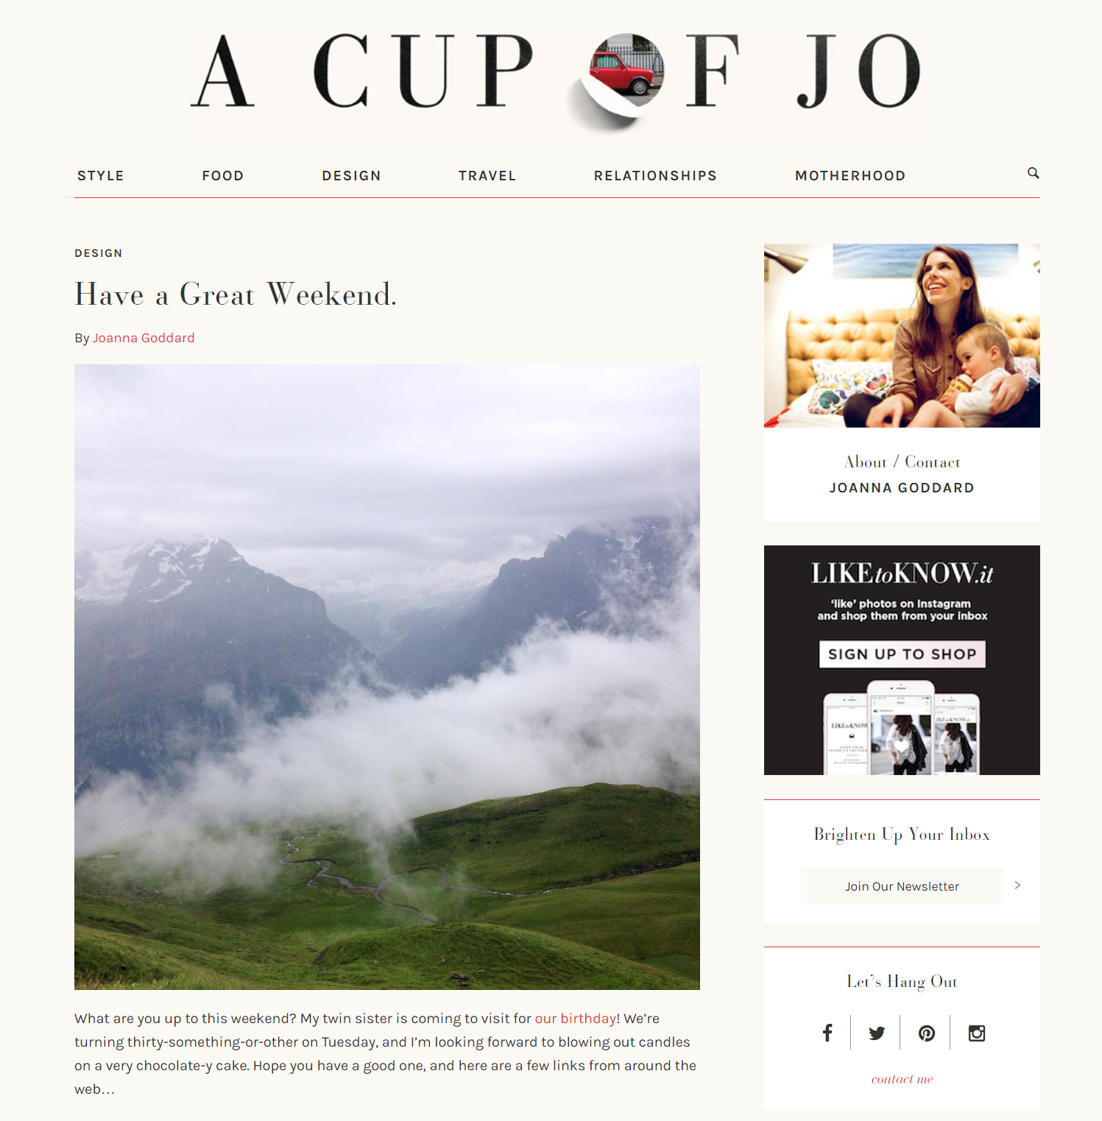
BLOG PEG A Cup of Jo http://cupofjo.com/

Slide 12
BLOG PEG The Glow http://www.theglow.com/

Slide 13
3-STEP PROCESS
Build Trust
Inform
Delight customers to become loyal advocates

Slide 14
3-STEP PROCESS
Build Trust
Inform
Delight customers to become loyal advocates

Slide 15
How do we build trust? We can’t immediately become “the baby authority,” we have to build trust first.
We re-inforce our successes through the years
Throwback to TPC’s history (related to Q1 social media campaign)
We tell people the story of what made us who we are today
make them say “okay pa pala yang TPC”
should HIGHLIGHT what we want to celebrate
We’re continuing to innovate
Highlight what would interest them, what people liked from the beginning
What’s in it for the mom?, Things they’ve wondered about
WHY WE’RE SO GREAT
Mixture of what we do today and flashbacks

Slide 16
3-STEP PROCESS
Build Trust
Inform
Delight customers to become loyal advocates

Slide 17
What do we inform the public? After building trust, we begin the information dissemination.
We begin posting about photography techniques we use in the studio, expertise of our photographers, baby know-how, what makes us great

Slide 18
3-STEP PROCESS
Build Trust
Inform
Delight customers to become loyal advocates

Slide 19
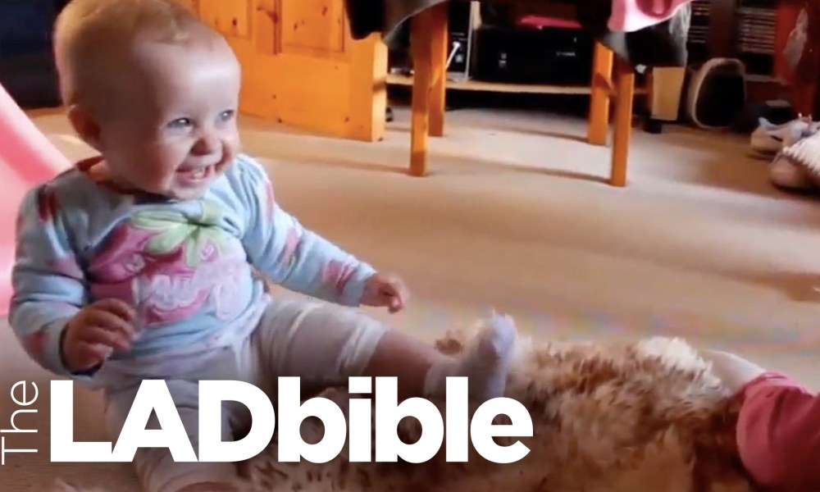
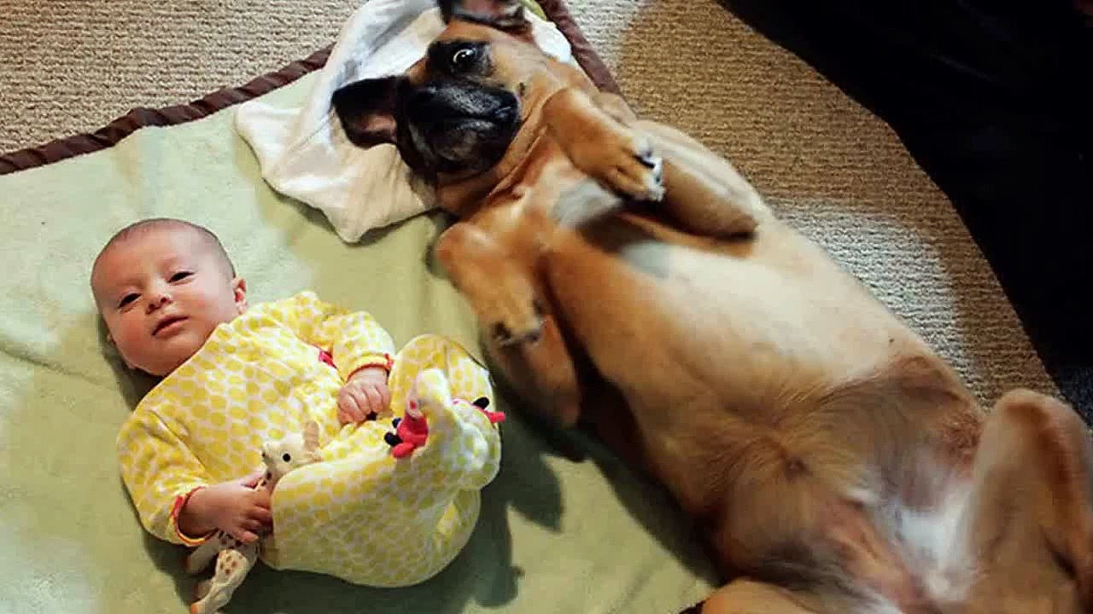
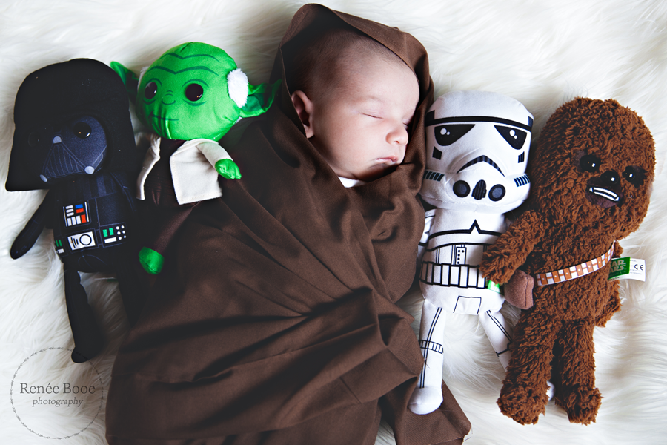
How do we delight people enough to make them our loyal advocates? After building trust and informing, we make them loyal advocates by wanting to see our pages regularly.
We can’t just start posting things unrelated to TPC during the beginning of the quarter when there’s no trust yet
Phase 3 is when we start posting random links, photos, GIFs, quotes, that are unrelated to TPC, but still related to babies, mommies, families, and photography

Slide 20
CONTENT TIMELINE Phase 1 BUILD TRUST
Week 1 Feb 1-4
How TPC was born
-interview Joaquin because he’s the reason why TPC was born
-POST HIS FIRST PORTRAIT, TPC’s first portrait
Week 2
Feb 5-11
Feature Story: First clients
Week 3
Feb 12-18
Baby Valentine stories (First valentine)
- daughter to dad
- son to mom
- kids to parents
How we celebrate love in TPC
Throwback
- Video: Interview with old clients
- PHOTOS: photo then and now, client who has grown
Look back on old TPC photos
Feature Story: First baby
Old TPC photogs
Old TPC family portraits
Cherish firsts
Baby’s first Valentine’s portraits
Remembering grandparents and their unconditional love
Celebrating all kinds of love #lovewins
Post phrases / words like:
- “copycats come and go”
- “we have photogs that care”
- WORDS WE’VE OWNED”
Feature photogs – company culture, bakit “galling your staff”, unique culture, give staff PROUD to be in TPC

Slide 21
CONTENT TIMELINE Phase 2 INFORM
Week 4
Feb 19-25
Week 5
Feb 26 - Mar 4
Week 6
Mar 5-11
What you can expect from TPC
Photography techniques TPC uses in the studio
What you get upon signing up for membership
TPC Baby Graduate
Hype on products
How we take great baby portraits
Expertise of TPC photogs / photogs that families love (Kern, Crystal, Ishee)
All about graduating
Baby of the week
Stories – graduating from being an only child to welcoming sibling
Stories – graduating from first tooth
Testimonials
Feature TPC portraits taken inside a house
Pwedeng fake: everything’s in a cloud
PHOTO: Kid who has grown holding sintra
PHOTOG FEATURES
- photog with grown baby (crystal, chiqui, aela)
- “i’ve been shooting this baby for years”

Slide 22
CONTENT TIMELINE Phase 3 DELIGHT CUSTOMERS TO BECOME LOYAL ADVOCATES
Week 7
Mar 12-18
History of Pictures
Week 8
Mar 19-25
Interview with families
Week 9
Mar 26 – Apr 1
April Fools: Funny Stories of Old Clients
Baby tips: How to change a diaper
#WackyWednesdays
#TestimonialTuesdays
#TriviaThursdays

Slide 23
Eileen’s Insights for Posts
Once a week – write quick articles on what you thought of
Testimonials – just write initials (ex: A.S., Makati)
MAIN GOAL SHOULD BE – write a book (about touching people, remembrance
book by the TPC – with photos of clients’ babies
(authority on) baby diaries
FRIDAYS
Can be blog on how to take great iPhone photos
how moms can teach yaya to take great iphone photos (we can make this into a book)
CLIENTS are not creative and they can’t control their babies, we provide the solution
WORDS WE WORK AROUND: fun, family, creative, premium

Slide 24
Social Media STRATEGY
2017

Slide 25
Target Market
Age range: 25 – 40
Female
Gadget: Mobile device, Desktop
Frequency – Every Wednesdays, Fridays, and weekends, 12nn and 6pm
Budget for ads: 40,000 per month or 120,000 per quarter
Projection: P 1.5 M per quarter / 500,000 per month
Percentage to sales: 10% of sales (quota – expense)
Profit: 460,000 per month

Slide 26
What worked Facebook
Posting FB ads on time basis (12nn, 6pm)
Posting FB ads with a related story -- e.g. On Christmas, I boost post Buy 1 take 1 on Family Portraits GC
Posting our products - GCs, Frames, Cash Voucher on ‘’SHOP’’ column - people are willng to buy and reserve online
Posting client reviews on regular basis - it made TPC G4 page’s in top search bar
Replying to inquiries within an hour - they reply fast and makes decisions fast
Active FB pages of all stores posting 2 photos everyday with strong call to action
Using rich media ads

Slide 27
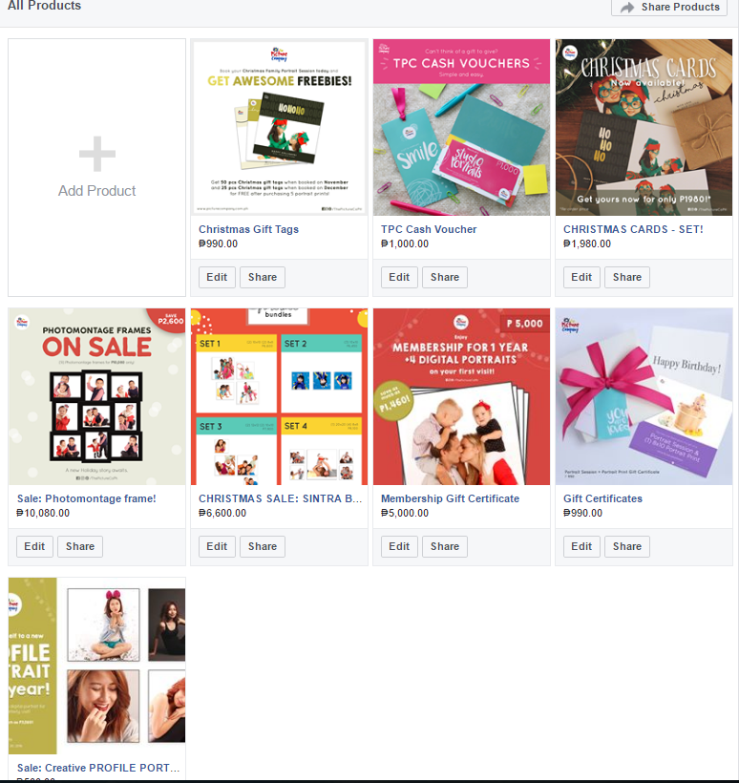

Slide 28
What worked Instagram
Sponsored ad – photo
Using hashtags

Slide 29
Metrics
RESULTS
Gather minimum of 50 inquiries / week
Inquiries must be converted to bookings every week
Produce 100k sales from GCs/Frames/Cash Vouchers every month
ADS
Produce 1 static ad per day
Produce 1 gif ad per day
Boost post an album per day
Produce 1 boomerang featuring our photogs per week
Produce 3 client testimonials per week

Slide 30
What didn’t work
Posting a video ad and not engaging client within the first 3 seconds
Posting an ad with too many texts - when I boost post it, i get low engagement rate

Slide 31
What we can do better
Repost client testimonials
Post more albums targeting family “creative/classic”
Re-post the Family Portrait Guide album - what clothes to wear, etc
Release ads as to what clients will expect on their 2nd year of membership
Advertise our clean and safe studios for babies -- we laundry every week
Advertise our photographers - expert in handling babies
Advertise that babies are safe in our studio even if the nanny will bring the baby
Create an instant link of our portfolio - Pinterest or an FB album that shows classic portraits for moms to share with her friends
Comfort the reluctant moms by ensuring we shoot newborn in the morning where the mall is not crowded yet.
Advertise on other website - e.g. Baby Center
Blog about TPC experience written by a blogger or blog site - When in Manila

Slide 32
12. Utilize Carousel Ads
13. Use my marketing mix to inspire conversations
14. Advertise our packaging (out of the box experience - e.g. Apple phone)
15. Utilize LCD ads in the malls/stores -- Research says 61% of respondents like to look ads in LCD screens
16. Turn to ads all the pains i gather in my market research every week
17. Produce more interesting things to tickle their curious minds (e.g. How do you take a baby’s portrait the TPC Way?)

Slide 33
Campaign for 2017
Campaign of the year – TPC 15 years and TIME
Rationale:
2017 is the 15th year of TPC. This is OUR year.
We have been around for 15 years, making us one of the experts in baby photography. We will show clients the reason how we have lasted this long, how we became who we are, why we have become experts in baby photography.
It’s all about being baby experts.
When we capture portraits, we capture the relevance time in memories. Portraits are the only memories we can hold on to when time has run out. We highlight time and its relevance in our campaigns.

Slide 34
Story Guide
What stories have we contributed to TPC families?
What stories are still alive and relevant to TPC families?
Why do we still exist?
What kind of happiness do we bring to clients?
What added value or meaning do our portraits give to the lives of clients?
What are the things to look out for in TPC as we turn 15 years? What’s in it for you?
What’s the importance and relevance of time with portraits?
How did TPC contribute to capturing time for families?
How did we make impact in our clients lives? – we are baby experts – moms can trust us, a reason to book your baby’s portrait session with us

Slide 35
Supported by TPC Blog
Sub-campaign Per month: initiative connected to 15 years & Time
Q1 – Feb and March FEB (Building Trust/Informing) TPC 15 years book Baby’s first Valentine’s portraits Remembering grandparents and their unconditional love Celebrating all kinds of love #lovewins | Q2 – April, May, June outdoor portraits mother’s day portraits with mom christmas in june | Q4– Oct, Nov, Dec christmas promotions all about family portraits reconnecting creating new stories
MARCH (Informing/Delighting Customers) all about graduating graduating from being an only child to welcoming sibling graduating from first tooth TPC baby graduate | Q3- July, August, Sept July – anniversary 15 years TPC 15 years book

Slide 36
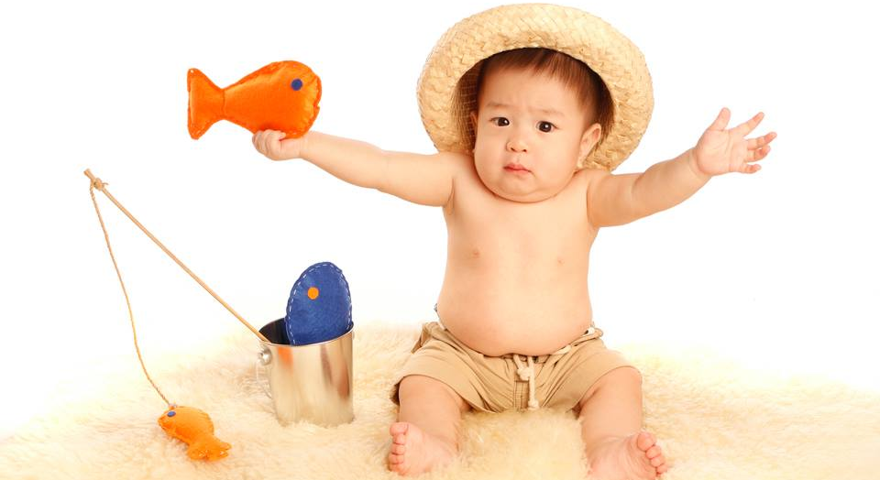
THE END.

